Slide 1

Machine Learning
Week 9

Slide 2

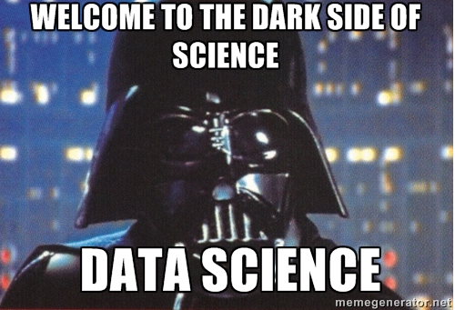
Agenda
Statistics vs Machine Learning
What is Machine Learning?
What is a good model?
Contextualizing ML Approaches
Defining an ML Problem
The Analytics Process
Model Development Workflow
Basic ML Concepts
Features vs Label / Target Variables
Domain Expertise
Feature Engineering
Train / Test Split
Baseline Model
Algorithms
Champion Model
Model Maintenance

Slide 3
Statistical Modeling vs Machine Learning
Statistical Model
Machine Learning
A statistical model is a mathematical model that embodies a set of statistical assumptions concerning the generation of sample data (and similar data from a larger population). A statistical model represents, often in considerably idealized form, the data-generating process.
A statistical model is usually specified as a mathematical relationship between one or more random variables and other non-random variables
ELI5:
Statistical models are designed for inference about the relationships between variables. Many statistical models can make predictions, but predictive accuracy is not their strength.
Machine learning (ML) is the study of computer algorithms that improve automatically through experience. It is seen as a subset of artificial intelligence.
Machine learning algorithms build a mathematical model based on sample data, known as "training data", in order to make predictions or decisions without being explicitly programmed to do so.
ELI5:
Machine learning models are designed to make the most accurate predictions possible by learning from historical data. Machine learning models provide various degrees of interpretability but generally sacrifice interpretability for predictive power.

Slide 4
Statistical Modeling vs Machine Learning
Statistical Model
Machine Learning
Mathematical formalization of relationships between variables, expressed in models that are then tested
Goal: Inference (Why is something happening? What is the relationship between variables of interest? What causes economic growth?)
Statisticians can help think about underlying data, possibilities for causal inference
Using algorithms to learn from data without necessarily specifying the model at the outset
Goal: Prediction (What is going to happen next? Will people who do X also do Y? What will be the level of the stock market one month from today?)
ML experts can help build algorithms to make predictions that we hope are good
Notes:
Two paths to one common goal - data science as the bridge between these two worlds
Overall differences:
• Statistics: Mathematical formalization of relationships between variables, expressed in models that are then tested
• Machine learning: Using algorithms to learn from data without necessarily specifying the model at the outset
• Goals, broadly, on average are both to learn from data, but they diverge slightly:
• Statistics: Inference (Why is something happening? What is the relationship between variables of interest? What causes
economic growth?)
• ML: Prediction (What is going to happen next? Will people who do X also do Y? What will be the level of the stock market
one month from today?
• Origins:
• Statistics: Mathematics (hundreds of years!); mathematics of collections of observations!
• ML: Computer science and artificial intelligence (term invented in 1959 at IBM, resurgence in 1990s); deep idea that
computers can learn from data
• Some tradeoffs:
• Statistics: We have to think carefully about how the data was measured and collected, formulate a model of how the
variables are related, understand the statistical properties of outputs (p-values, coefficients, etc.), underlying distribution
of the population, LLN (ideas and inferences about what would happen if we did the same study many times). BUT: we do
get a bit more insight to understand relationships between variables
• Machine learning: Not necessary to have prior assumptions about the relationships between the variables, generally
need a lot of data for prediction. BUT: the output can be a black box — we don’t necessarily know why the prediction is
what it is, or better understand the relationship between underlying variables

Slide 5
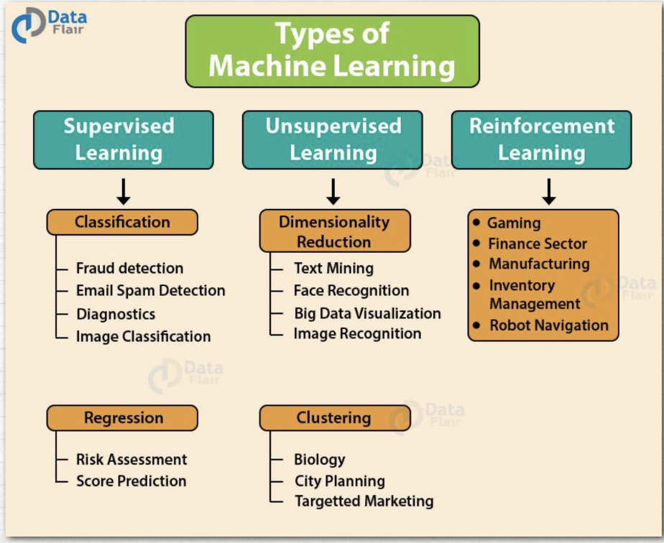
What is Machine Learning?
Supervised or semi-supervised
Both inputs and outputs (X and Y)
We train the data on the relationship between the two, then test and make predictions
Example: annual promotion scores, top songs on Spotify
Two major types: regression and classification
Unsupervised
Only inputs and then finds structures based on the data, like clusters or categories based on similarities
Models learn relationships between data
Examples: Grouping customers by purchasing behavior, spam filters in email
Reinforcement
Inputs are given, and then the model is “rewarded” or “punished” based on output, evolves based on trial and error
Examples: AI playing games (AlphaGo Zero), robotics, self-driving cars, online stock trading
Notes:
Two paths to one common goal
Overall differences:
• Statistics: Mathematical formalization of relationships between variables, expressed in models that are then tested
• Machine learning: Using algorithms to learn from data without necessarily specifying the model at the outset
• Goals, broadly, on average are both to learn from data, but they diverge slightly:
• Statistics: Inference (Why is something happening? What is the relationship between variables of interest? What causes
economic growth?)
• ML: Prediction (What is going to happen next? Will people who do X also do Y? What will be the level of the stock market
one month from today?
• Origins:
• Statistics: Mathematics (hundreds of years!); mathematics of collections of observations!
• ML: Computer science and artificial intelligence (term invented in 1959 at IBM, resurgence in 1990s); deep idea that
computers can learn from data
• Some tradeoffs:
• Statistics: We have to think carefully about how the data was measured and collected, formulate a model of how the
variables are related, understand the statistical properties of outputs (p-values, coefficients, etc.), underlying distribution
of the population, LLN (ideas and inferences about what would happen if we did the same study many times). BUT: we do
get a bit more insight to understand relationships between variables
• Machine learning: Not necessary to have prior assumptions about the relationships between the variables, generally
need a lot of data for prediction. BUT: the output can be a black box — we don’t necessarily know why the prediction is
what it is, or better understand the relationship between underlying variables

Slide 6
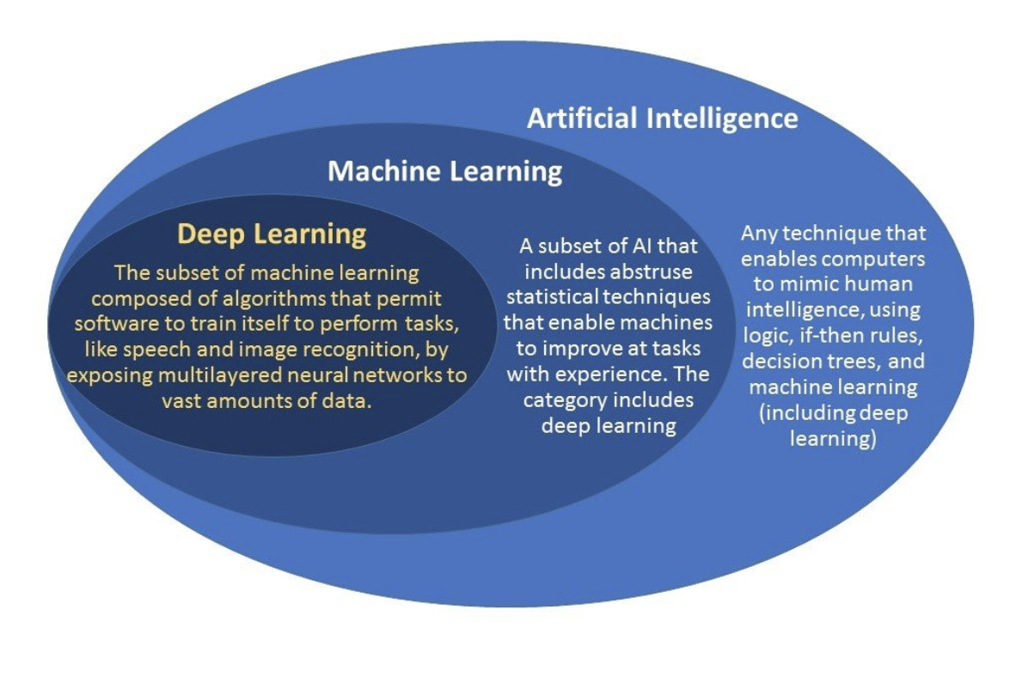
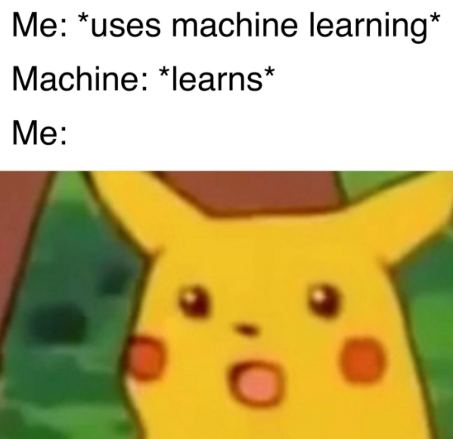
What is Machine Learning?
Notes:
https://medium.com/@harish_6956/what-is-machine-learning-deep-learning-7788604004da

Slide 7
What defines a good model?
Model Fit
Goodness of Fit - whether model adequately describes the relations in the current data
Prediction Accuracy - whether model adequately predicts new data
Parsimony
A parsimonious model is a model that accomplishes a desired level of explanation or prediction with as few predictor variables as possible
Usability
Data Requirements
Technology Requirements
Training and Scoring Performance
Notes:
Two paths to one common goal
Overall differences:
• Statistics: Mathematical formalization of relationships between variables, expressed in models that are then tested
• Machine learning: Using algorithms to learn from data without necessarily specifying the model at the outset
• Goals, broadly, on average are both to learn from data, but they diverge slightly:
• Statistics: Inference (Why is something happening? What is the relationship between variables of interest? What causes
economic growth?)
• ML: Prediction (What is going to happen next? Will people who do X also do Y? What will be the level of the stock market
one month from today?
• Origins:
• Statistics: Mathematics (hundreds of years!); mathematics of collections of observations!
• ML: Computer science and artificial intelligence (term invented in 1959 at IBM, resurgence in 1990s); deep idea that
computers can learn from data
• Some tradeoffs:
• Statistics: We have to think carefully about how the data was measured and collected, formulate a model of how the
variables are related, understand the statistical properties of outputs (p-values, coefficients, etc.), underlying distribution
of the population, LLN (ideas and inferences about what would happen if we did the same study many times). BUT: we do
get a bit more insight to understand relationships between variables
• Machine learning: Not necessary to have prior assumptions about the relationships between the variables, generally
need a lot of data for prediction. BUT: the output can be a black box — we don’t necessarily know why the prediction is
what it is, or better understand the relationship between underlying variables

Slide 8
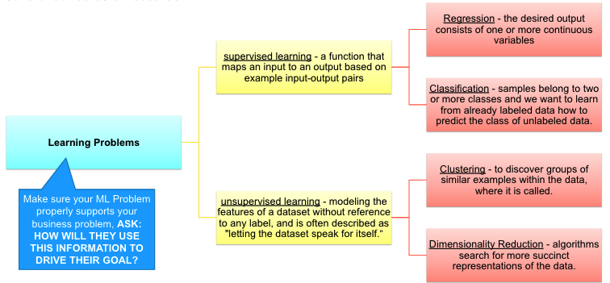
Contextualizing ML Approaches: Defining an ML Problem
In general, a learning problem considers a set of n samples of data and then tries to predict properties of unknown data. If each sample is more than a single number and, for instance, a multi-dimensional entry (aka multivariate data), it is said to have several attributes or features.
Notes:
Two paths to one common goal
Overall differences:
• Statistics: Mathematical formalization of relationships between variables, expressed in models that are then tested
• Machine learning: Using algorithms to learn from data without necessarily specifying the model at the outset
• Goals, broadly, on average are both to learn from data, but they diverge slightly:
• Statistics: Inference (Why is something happening? What is the relationship between variables of interest? What causes
economic growth?)
• ML: Prediction (What is going to happen next? Will people who do X also do Y? What will be the level of the stock market
one month from today?
• Origins:
• Statistics: Mathematics (hundreds of years!); mathematics of collections of observations!
• ML: Computer science and artificial intelligence (term invented in 1959 at IBM, resurgence in 1990s); deep idea that
computers can learn from data
• Some tradeoffs:
• Statistics: We have to think carefully about how the data was measured and collected, formulate a model of how the
variables are related, understand the statistical properties of outputs (p-values, coefficients, etc.), underlying distribution
of the population, LLN (ideas and inferences about what would happen if we did the same study many times). BUT: we do
get a bit more insight to understand relationships between variables
• Machine learning: Not necessary to have prior assumptions about the relationships between the variables, generally
need a lot of data for prediction. BUT: the output can be a black box — we don’t necessarily know why the prediction is
what it is, or better understand the relationship between underlying variables

Slide 9
The Analytics Process
Deployment simply means getting the analytics model used as to how it’s intended to address the business problem, so that it involves interacting with the business users who will use the model or results of the model. That said, there are different methods to deploy the models, but the following tasks need to be performed regardless of the method chosen by the user:
Perform business validation of the model
Deliver report with findings; or
Create model, usability, and system requirements for production
Deliver production model/system
Support deployment
Business Problem Framing
Analytics Problem Framing
Data Requirements
Methodology Selection
Model building
Deployment
Model Lifecycle Management

